Slide 1



WEB DEVELOPMENT

Slide 2

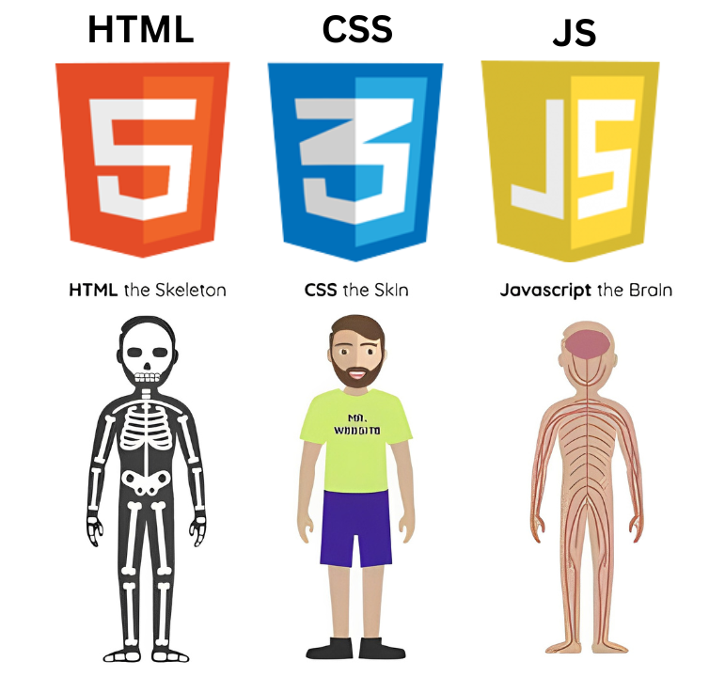

WHAT IS A WEBSITE MADE UP OF?
HTML: The skeleton – provides structure.
CSS: The skin and style – defines appearance.
JavaScript: The brain – adds behavior and interactivity.

Slide 3

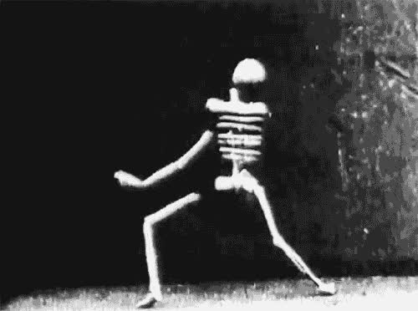

HTML

Slide 4
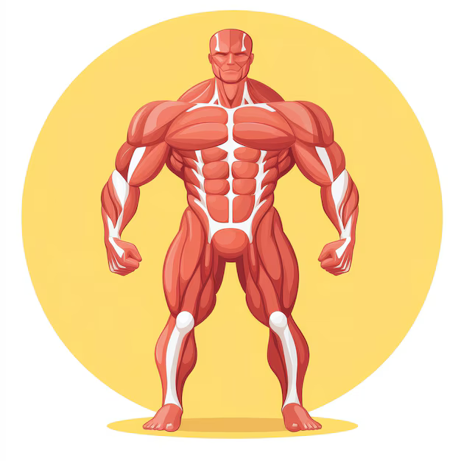
CSS

Slide 5
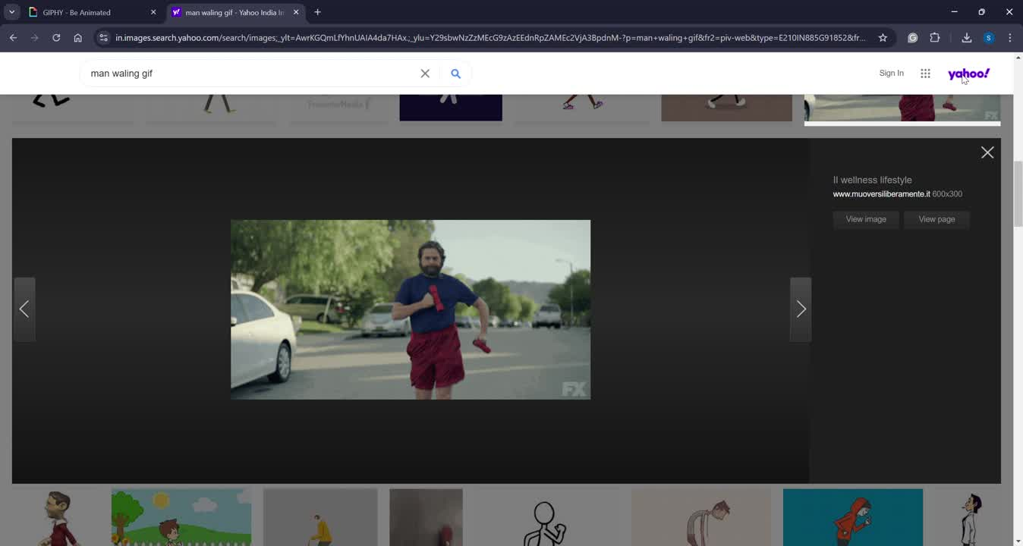
JAVASCRIPT

Slide 6

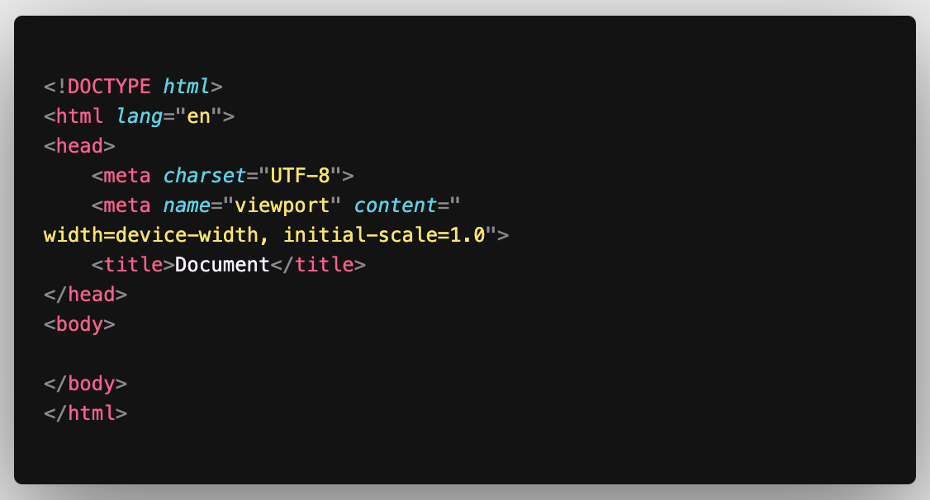

HTML-BOILER PLATE

Slide 7

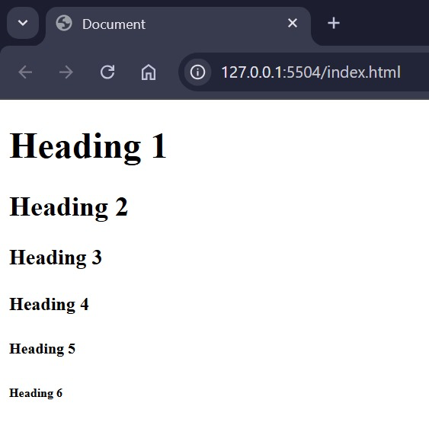
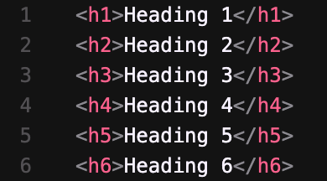
HTML TAGS
Heading tag:

Slide 8
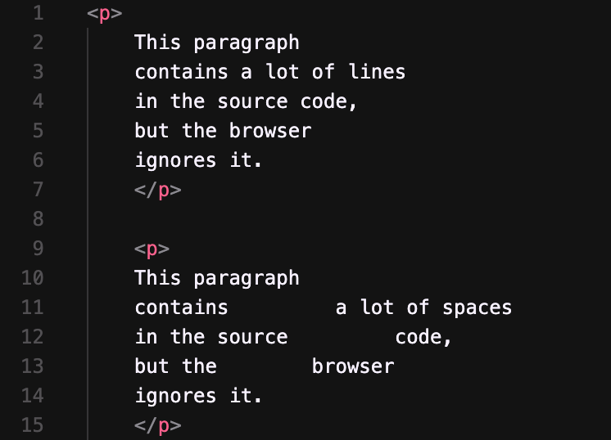
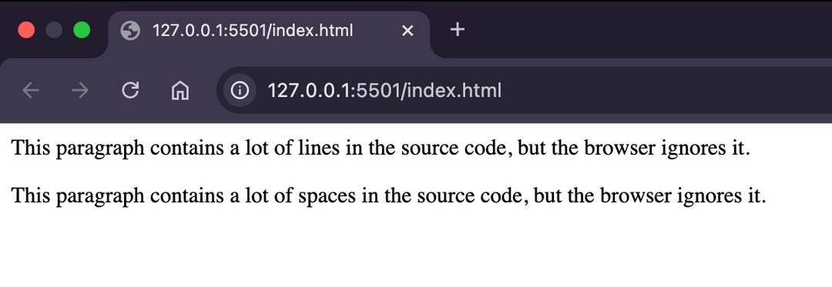
HTML TAGS
Paragraph tag:

Slide 9
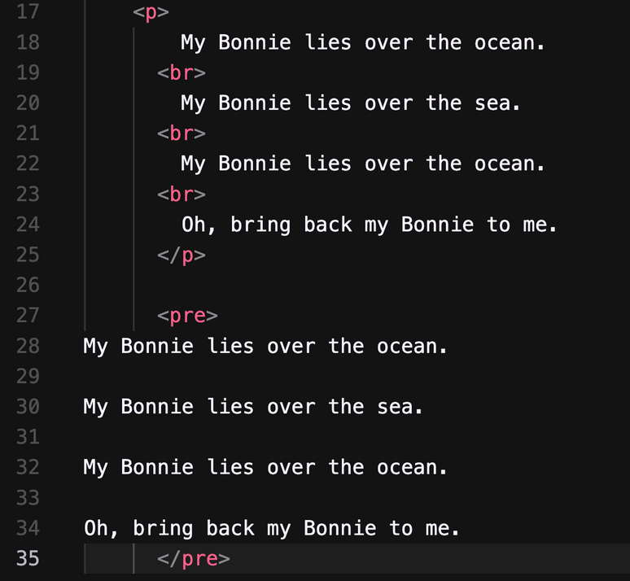
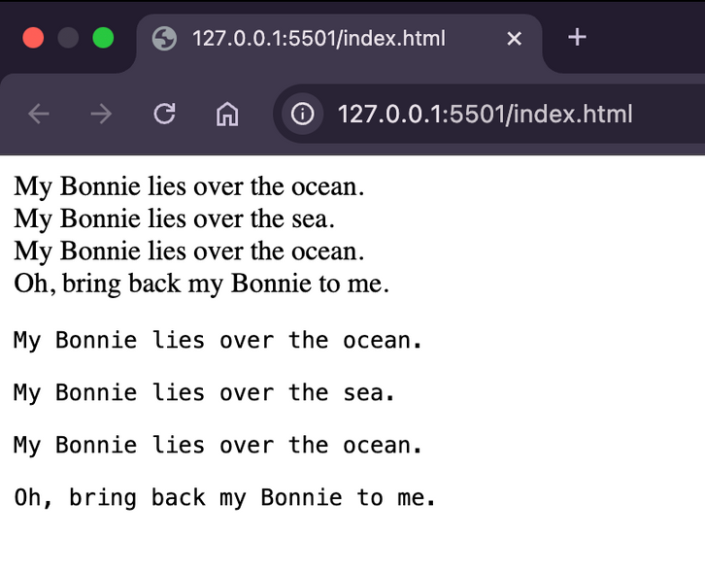
HTML TAGS
Paragraph tag:

Slide 10
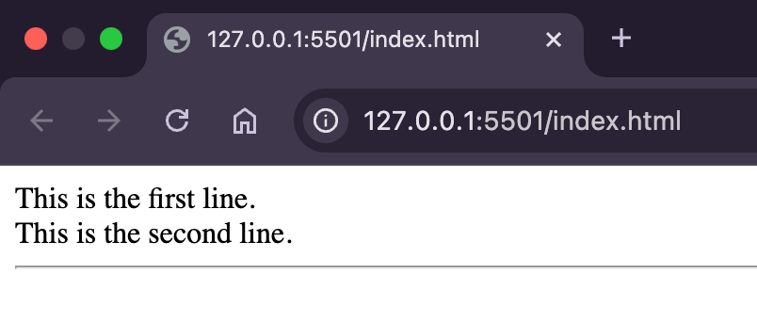
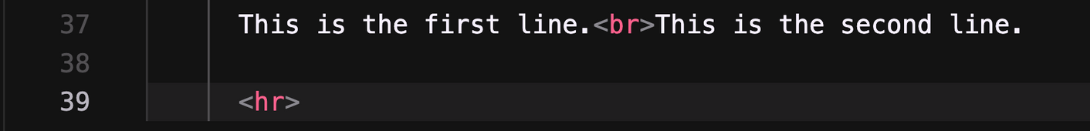
HTML TAGS
Line Break & Horizontal Rule

Slide 11
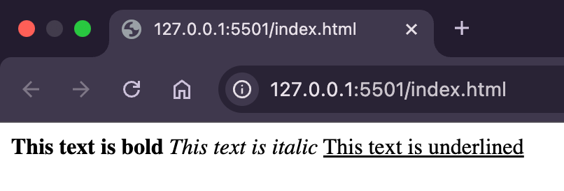
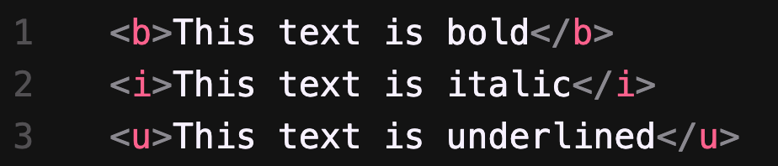
HTML TAGS
Formatting Text

Slide 12
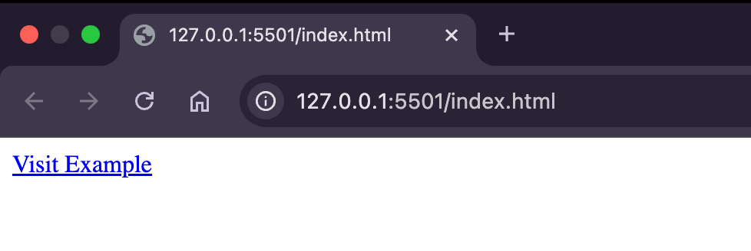
HTML TAGS
Links and Navigation

Slide 13
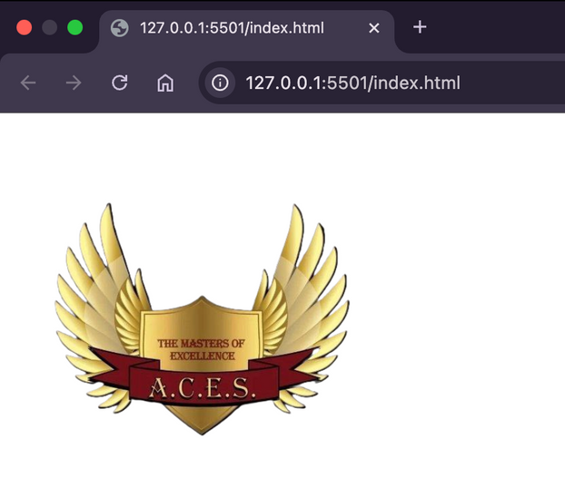
HTML TAGS
Images

Slide 14
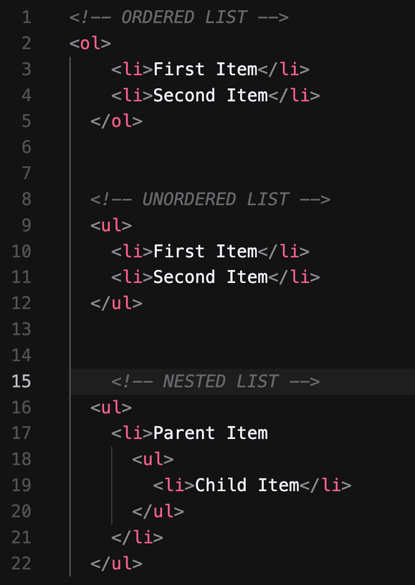
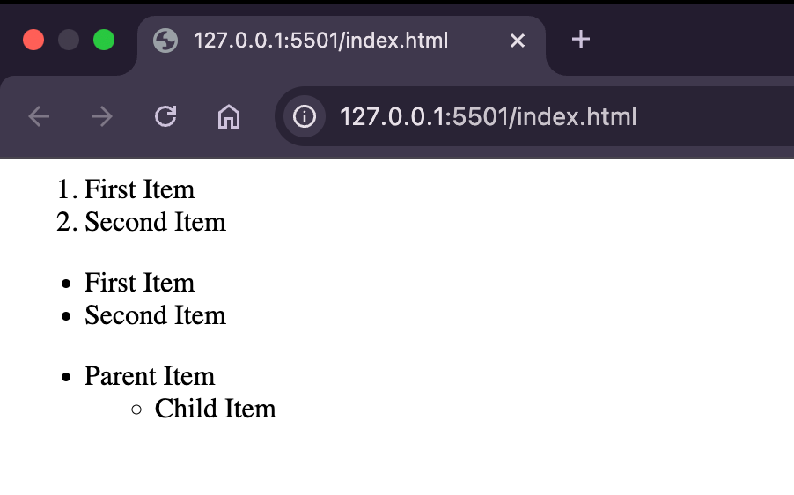
HTML TAGS
Lists

Slide 15
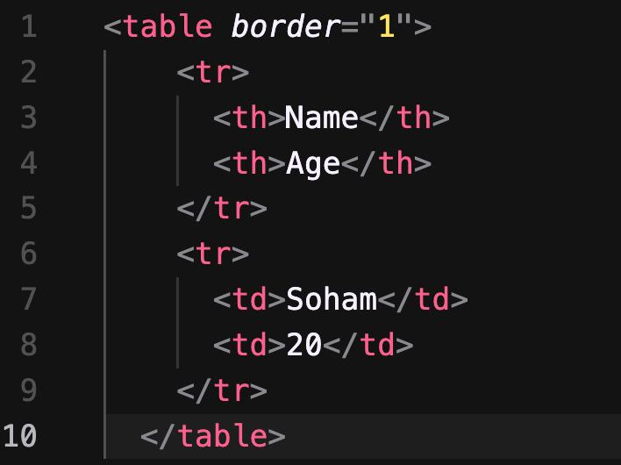
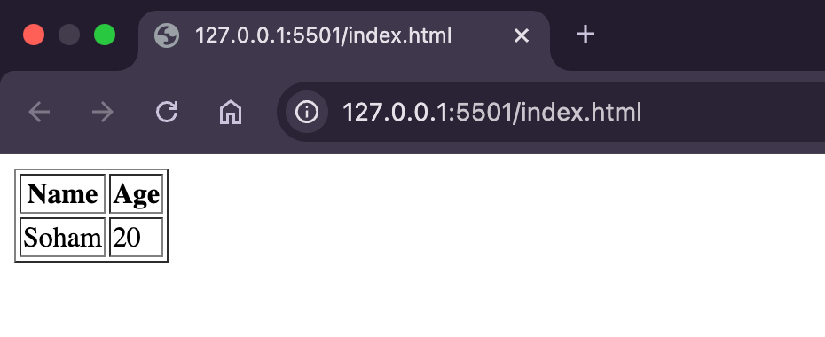
HTML TAGS
Table

Slide 16
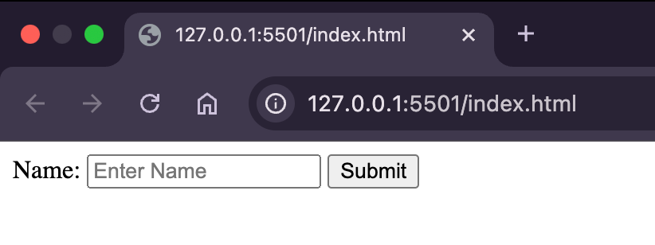
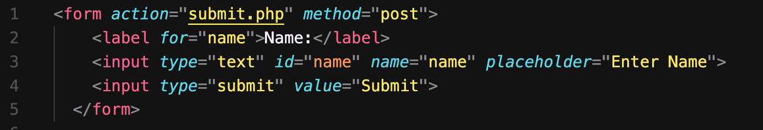
HTML TAGS
Forms

Slide 17
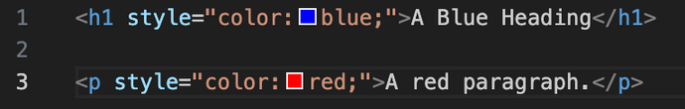
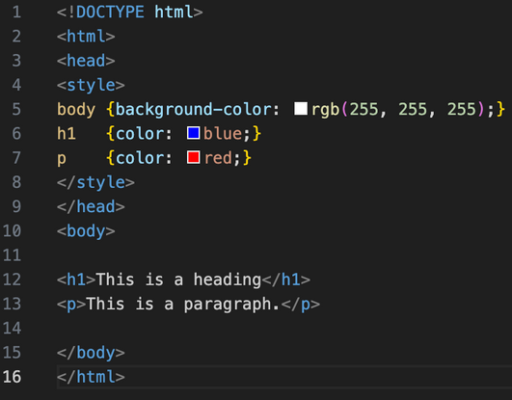
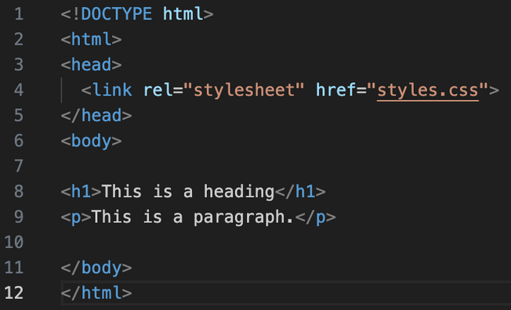


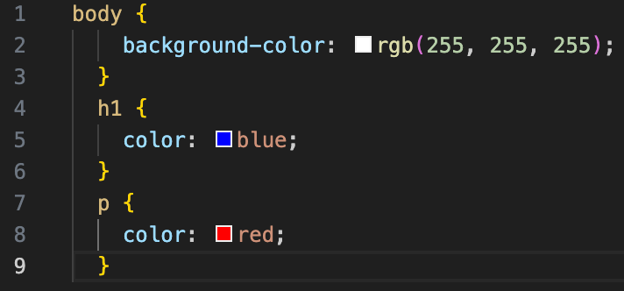
HTML & CSS

Slide 18
HTML & CSS
Inline
Internal
External

Slide 19
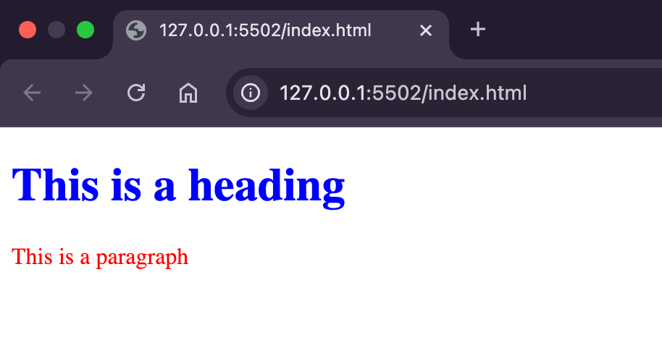
HTML & CSS

Slide 20
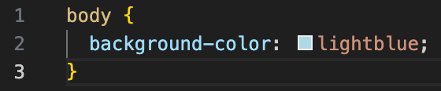
CSS SYNTAX
Selector
Property
Value

Slide 21
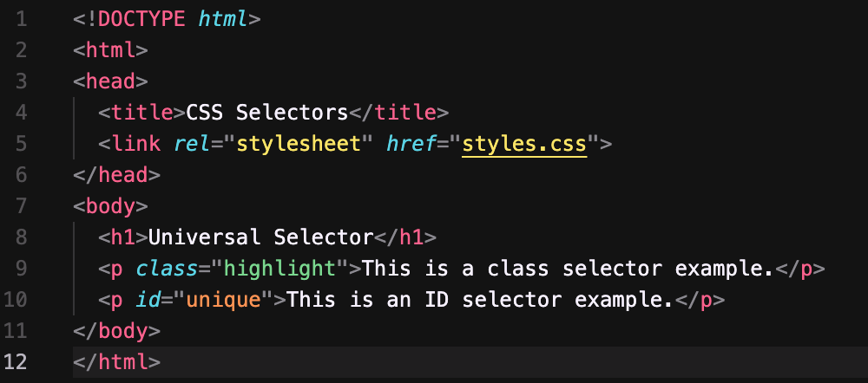
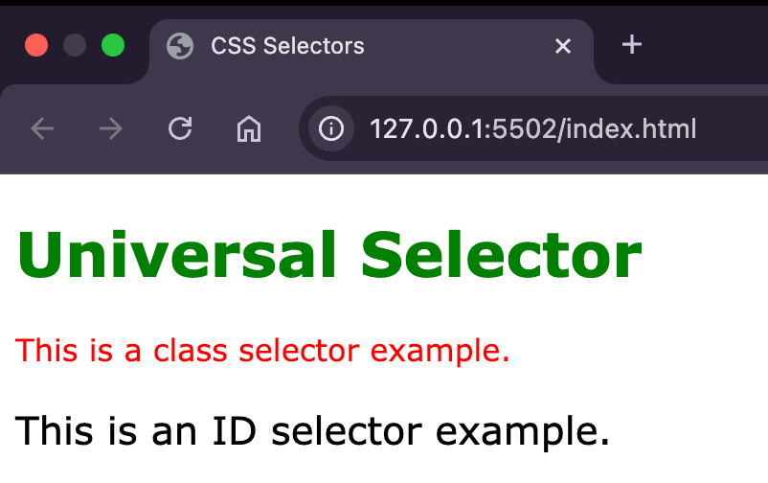
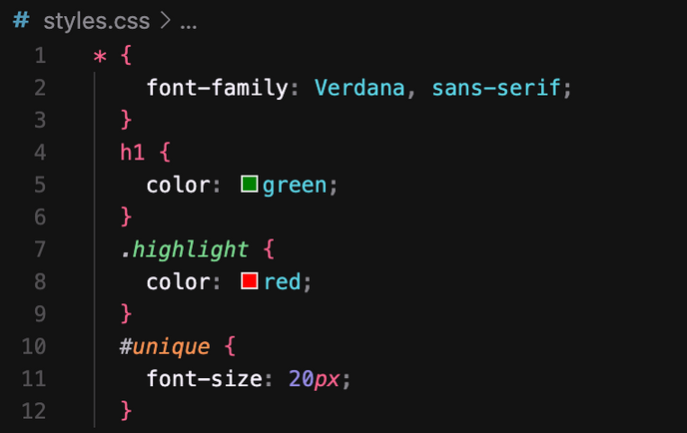
CSS: SELECTORS
Selectors:
Universal: *
Class: .class_name
ID: #id_name

Slide 22
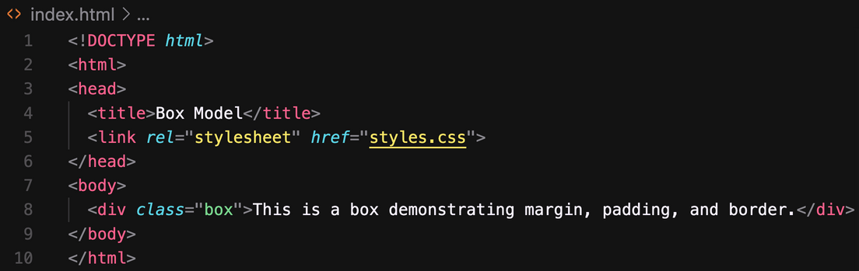
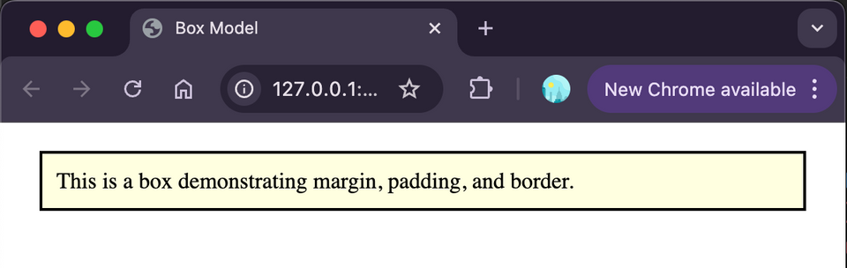
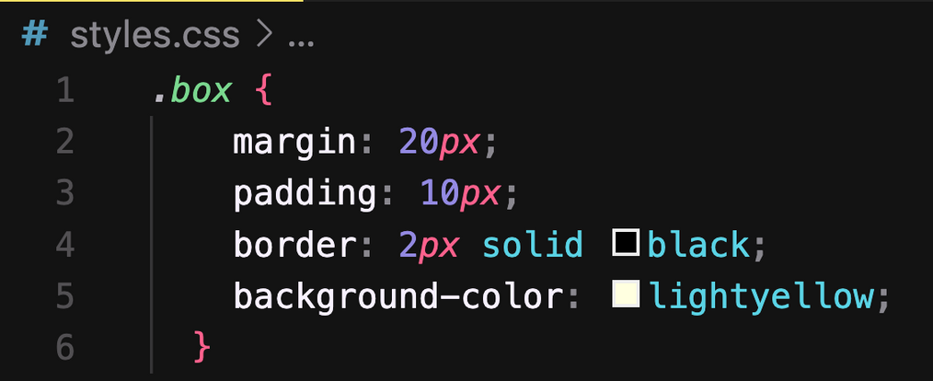
CSS: MARGINS, PADDING, AND BORDERS

Slide 23
DAY 2

Slide 24
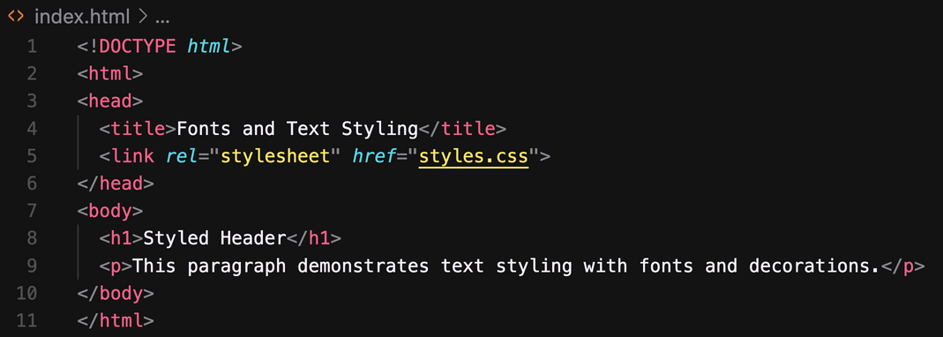
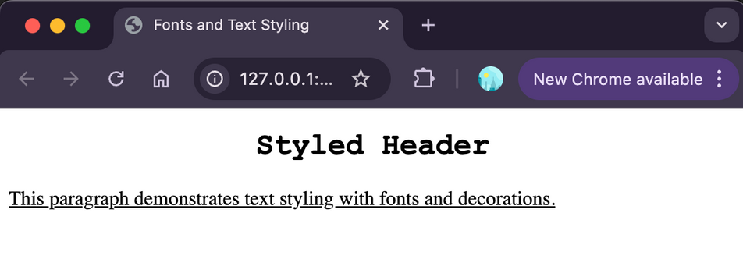
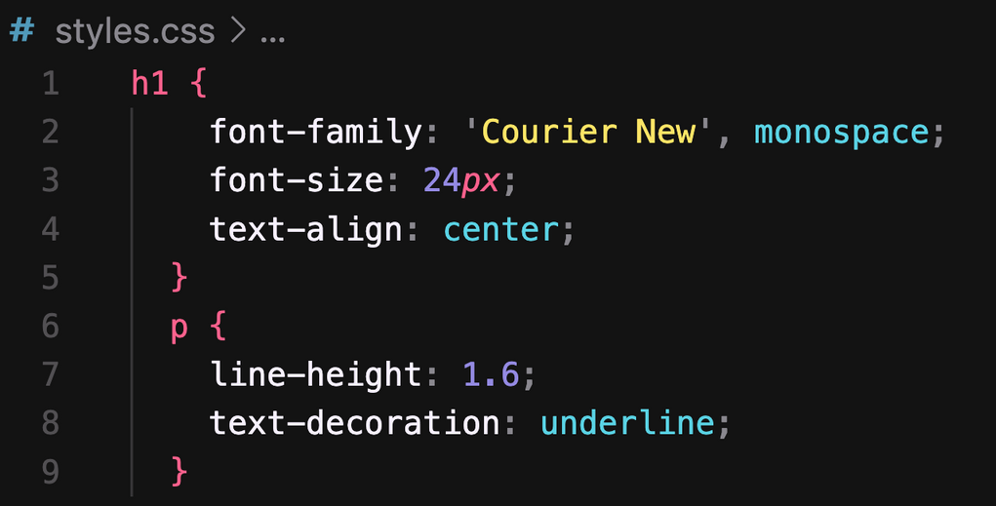
CSS: FONTS AND TEXT STYLING

Slide 25
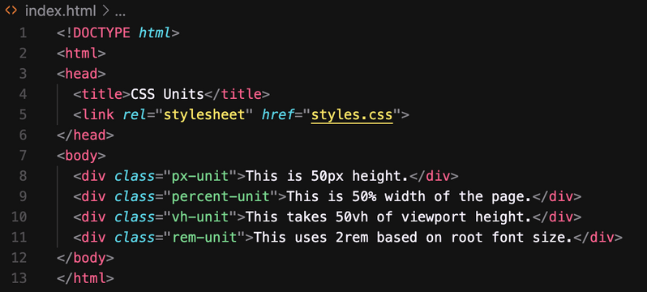
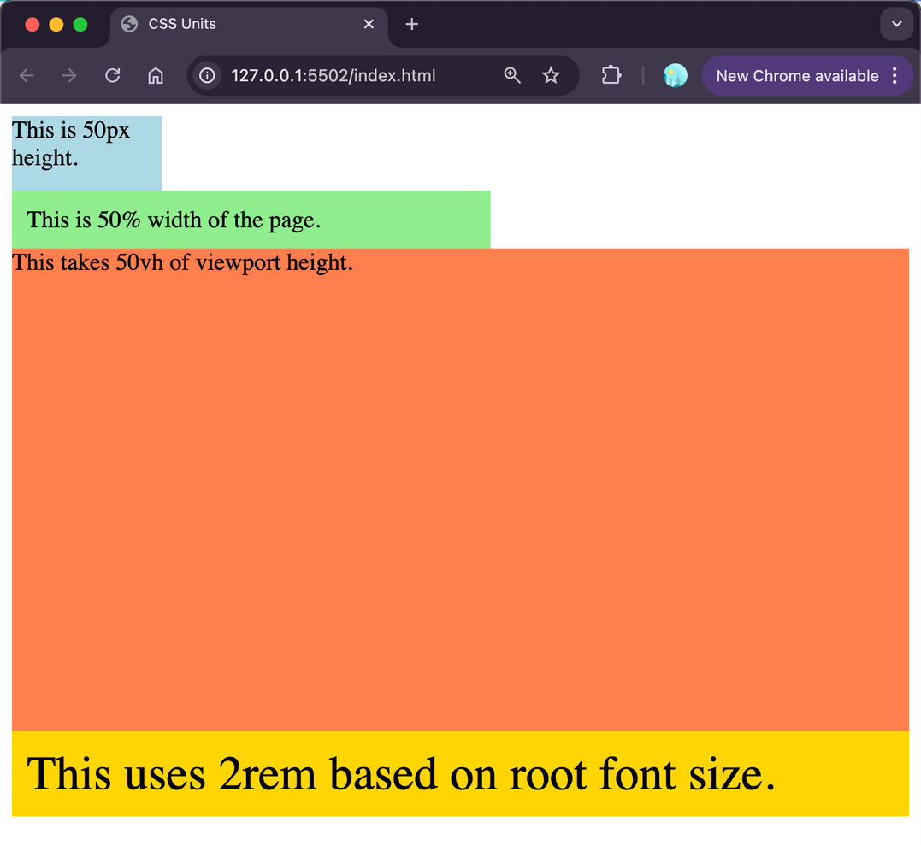
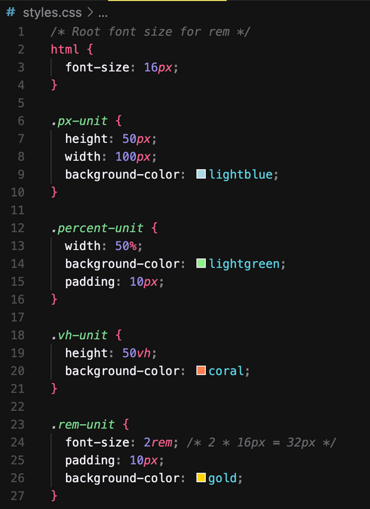
CSS: UNITS

Slide 26
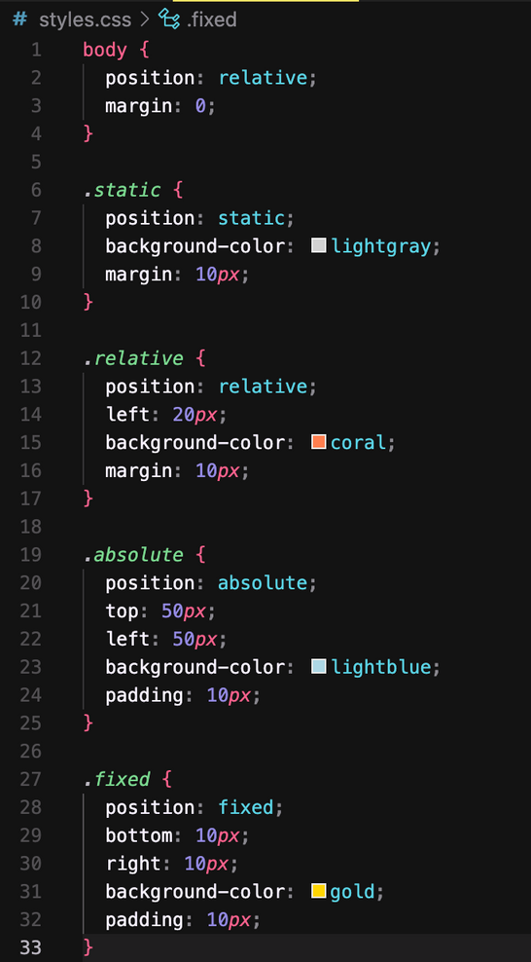
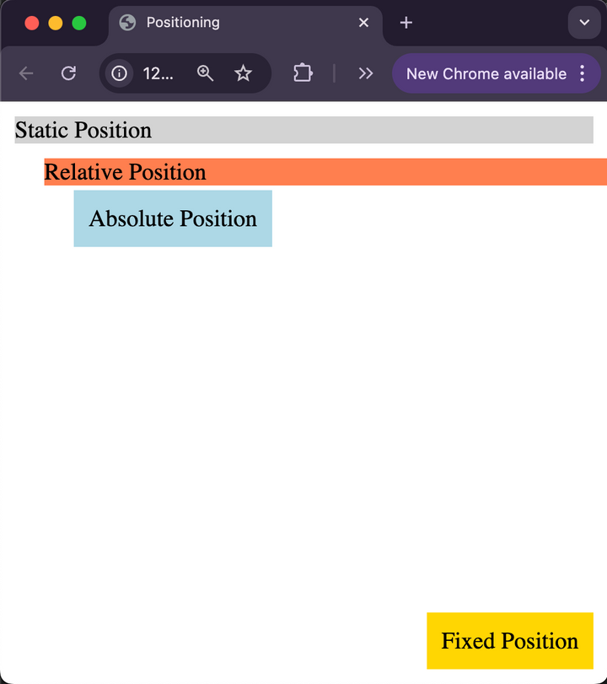
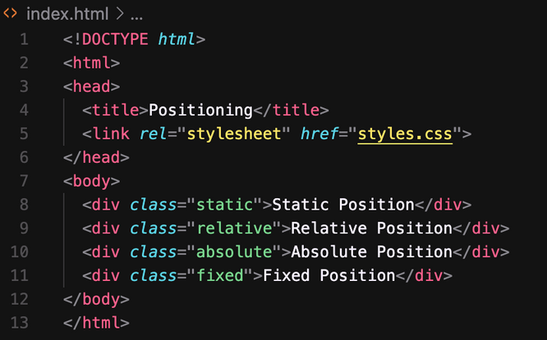
CSS: LAYOUTS- POSITIONING

Slide 27
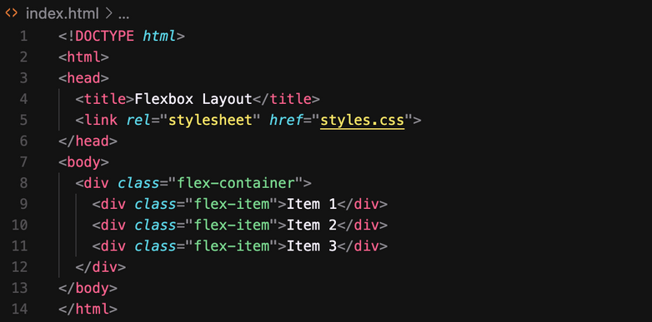
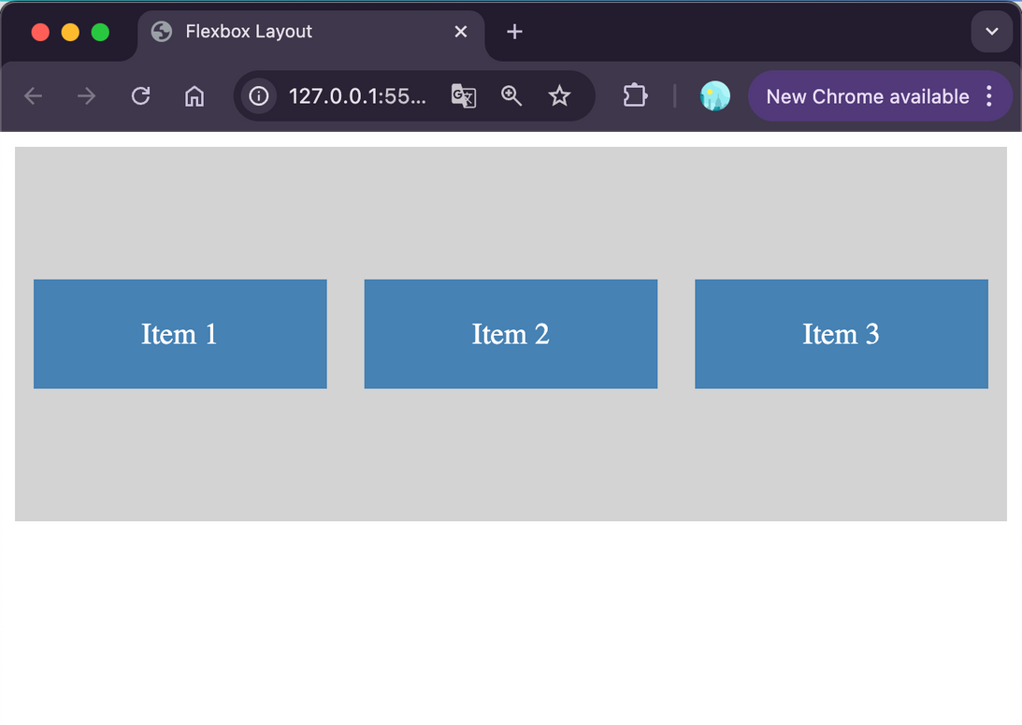
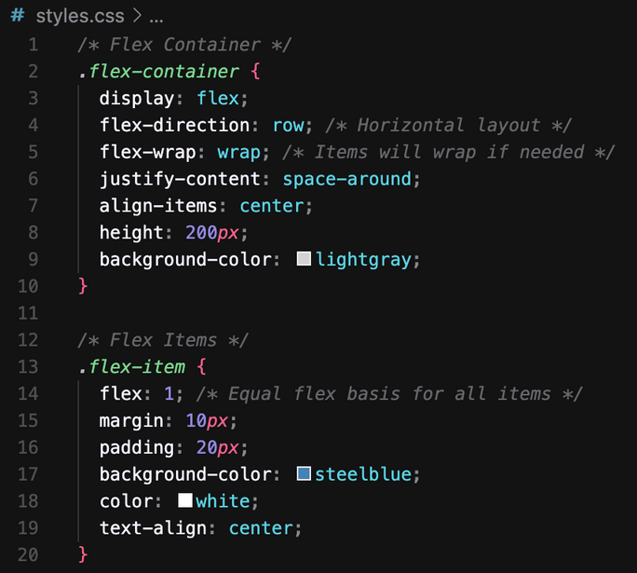
CSS: LAYOUTS- FLEX

Slide 28
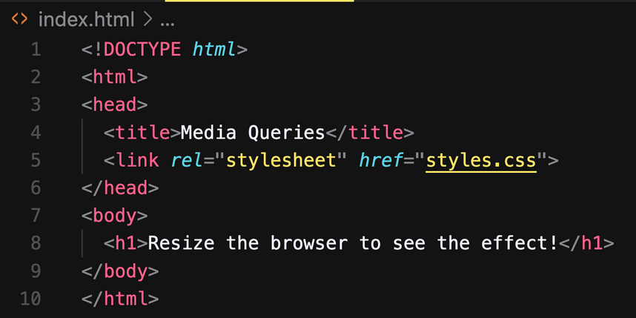
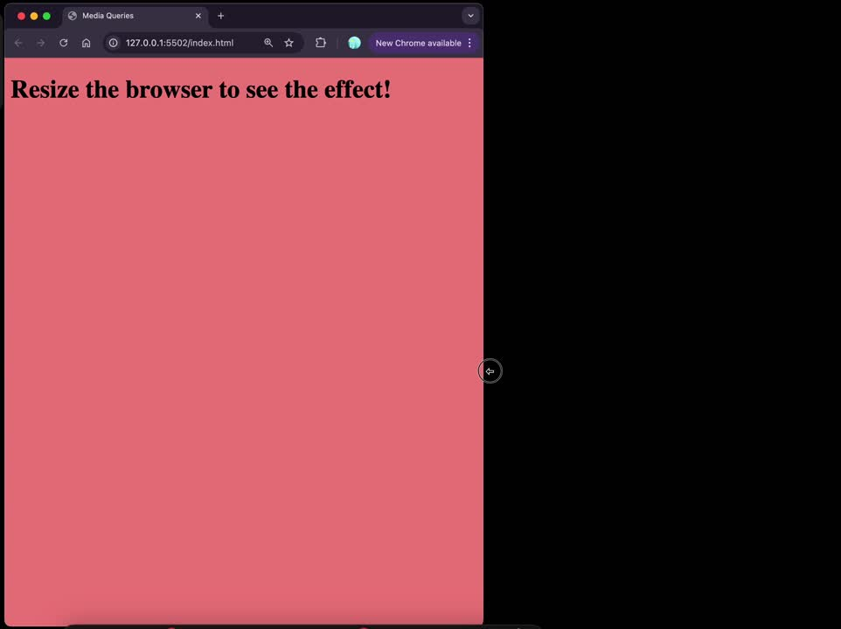
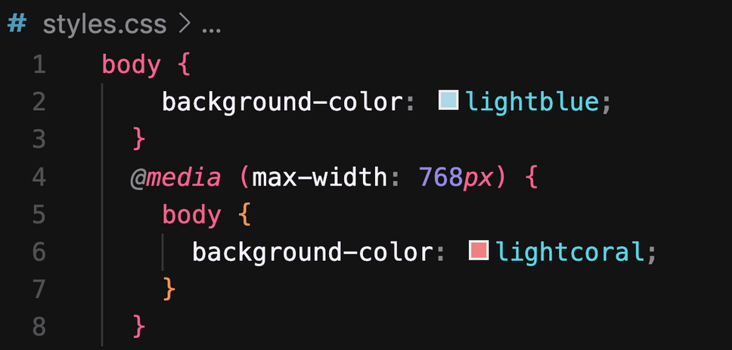
CSS: MEDIA QUERIES
max-height, min-width, min-height

Slide 29



BEST PRACTICES

Slide 30
DAY 4

Slide 31
JAVASCRIPT

Slide 32

JS & HTML

Slide 33
JS- WORD VS KEYWORD
Aspect | word | keyword
Definition | Any string or identifier in JavaScript. | Reserved words with specific meanings.
purpose | Used as names for variables, functions, etc. | Used to define JavaScript syntax or logic.
example | myVar, calculate, userName | if, else, let, const, return
restriction | Can be user-defined and custom. | Cannot be used as identifiers or variables.

Slide 34


JS- VAR, LET, CONST

Slide 35




JS- HOISTING

Slide 36


JS- TYPES
Primitive
Referenced

Slide 37


JS- CONDITIONALS
if
else
else if

Slide 38


JS- LOOPS
while
for

Slide 39


JS- FUNCTIONS

Slide 40


JS- ARRAY

Slide 41


JS- OBJECT

Slide 42
JS- DOM
Document Object Model
Four pillars of DOM:
1) Selection of a element
2) Changing HTML
3) Changing CSS
4)Event Listener

Slide 43


DOM- SELECTION OF A ELEMENT
Purpose: To identify and select specific elements in the DOM for manipulation.
Types:
• By ID: document.getElementById()
• By Class: document.getElementsByClassName()
• By Tag Name: document.getElementsByTagName()
• By CSS Selector: document.querySelector() and document.querySelectorAll()

Slide 44




DOM- CHANGING HTML
Purpose: Modify the structure or content of the selected elements..
Types:
• Changing inner content: .innerHTML or .textContent
• Changing attributes: .setAttribute() or .removeAttribute()

Slide 45



DOM- CHANGING CSS
Purpose: Alter the styling of selected elements..
Types:
• Inline CSS: Modify styles using .style
• Add/Remove Classes: Use .classList.add(), .classList.remove(), .classList.toggle()

Slide 46


DOM- EVENT LISTENER
Purpose: Respond to user interactions or other events..
Types:
• Mouse Events: click, mouseover, mouseout
• Keyboard Events: keydown, keyup
• Form Events: submit, change, focus
• Other Events: load, resize

